Slide 1
UNIT 2 & UNIT 3: User interface component with Swing Event Handling

Slide 2
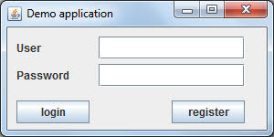
2.1 Java Swing
Java Swing is a part of Java Foundation Classes (JFC) that is used to create window-based applications. It is built on the top of AWT (Abstract Windowing Toolkit) API and entirely written in java.
Unlike AWT, Java Swing provides platform-independent and lightweight components.
The javax.swing package provides classes for java swing API such as JButton, JTextField, JTextArea, JRadioButton, JCheckbox, JMenu, JColorChooser etc.

Slide 3
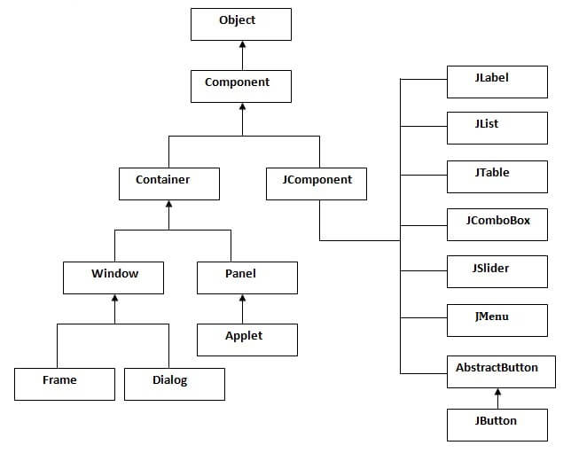
Hierarchy of Java Swing classes

Slide 4
Commonly used Methods of Component class
The methods of Component class are widely used in java swing that are given below.
Method | Description
public void add(Component c) | add a component on another component.
public void setSize(int width,int height) | sets size of the component.
public void setLayout(LayoutManager m) | sets the layout manager for the component.
public void setVisible(boolean b) | sets the visibility of the component. It is by default false.

Slide 5
Difference between AWT and Swing
There are many differences between java awt and swing that are given below.
Java AWT | Java Swing
AWT components are platform-dependent. AWT components are heavyweight. AWT doesn't support pluggable look and feel. AWT provides less components than Swing. AWT doesn't follows MVC(Model View Controller) where model represents data, view represents presentation and controller acts as an interface between model and view. | Java swing components are platform-independent. Swing components are lightweight. Swing supports pluggable look and feel. Swing provides more powerful components such as tables, lists, scrollpanes, colorchooser, tabbedpane etc. Swing follows MVC.

Slide 6
2.3 Text Input
Text Fields, Password Fields, Text Areas, Scroll Pane, Label and Labeling Components
textField = new JTextField(20);
The actionPerformed method handles action events
from the text field:
private final static String newline = "\n";
...
public void actionPerformed(ActionEvent evt) {
String text = textField.getText();
textArea.append(text + newline);
textField.selectAll();
}
A text field is a basic text control that enables the user to type a small amount of text.
When the user indicates that text entry is complete (usually by pressing Enter), the text field fires an action event.
If you need to obtain more than one line of input from the user, use a text area.
JTextField : basic text fields.
JPasswordField: A JTextField subclass that does not show the characters that the user types.

Slide 7
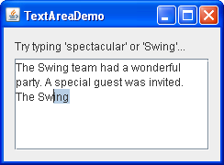
The JTextArea class provides a component that displays multiple lines of text and optionally allows the user to edit the text.
If you need to obtain only one line of input from the user, you should use a text field.
If you want the text area to display its text using multiple fonts or other styles, you should use an editor pane or text pane.
If the displayed text has a limited length and is never edited by the user, use a label.
textArea = new JTextArea(5, 20);
JScrollPane scrollPane = new JScrollPane(textArea);
textArea.setEditable(false);

Slide 8
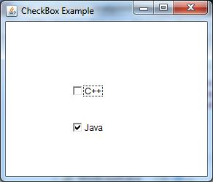
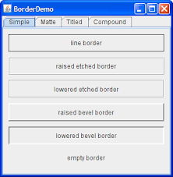
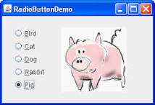
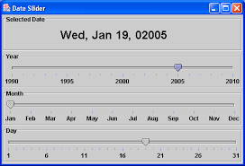
2.4 Choice Components
Check Boxes, Radio Buttons, Borders, Sliders

Slide 9
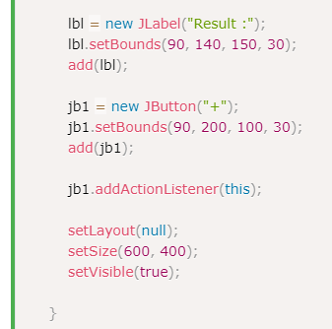

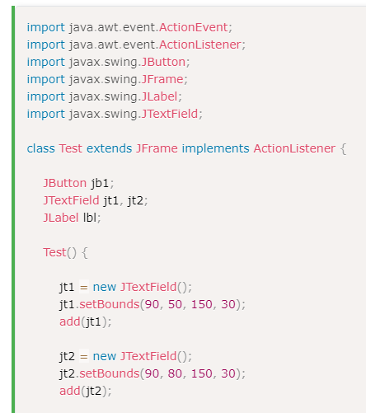
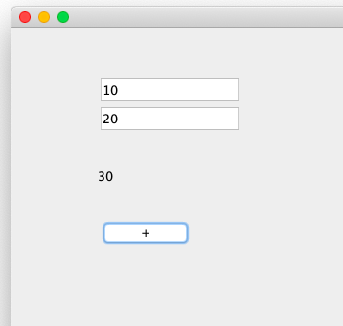
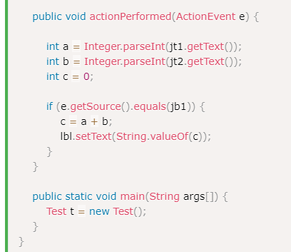

Slide 10
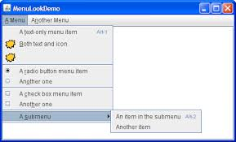
2.5 Menus
JMenuBar menuBar;
JMenu menu, submenu;
JMenuItem menuItem;
JRadioButtonMenuItem rbMenuItem;
JCheckBoxMenuItem cbMenuItem;
..........
//Create the menu bar.
menuBar = new JMenuBar();
............
//Build the first menu.
menu = new JMenu("A Menu");
menuBar.add(menu);
...............
//a group of JMenuItems
menuItem = new JMenuItem("A text-only menu item",KeyEvent.VK_T);
................
menuItem = new JMenuItem("Both text and icon",
new ImageIcon("images/middle.gif"));
....................
menu.addSeparator();
Menu Building, Icons in Menu Items, Check box and Radio Buttons in Menu Items, op-up Menus, Keyboard Mnemonics and Accelerators, Enabling and Disabling menu Items, Toolbars, Tooltips

Slide 11
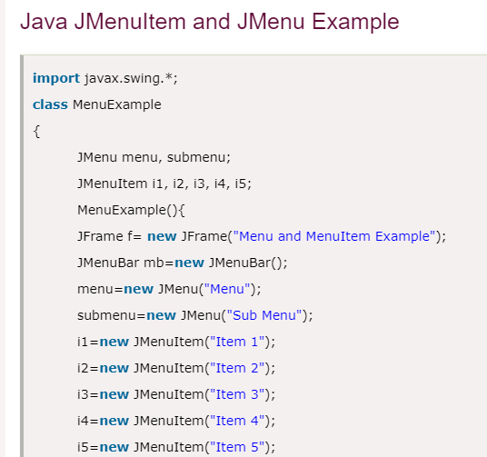
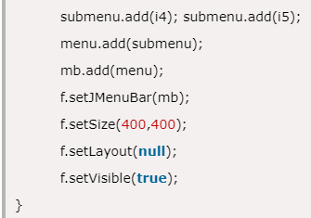
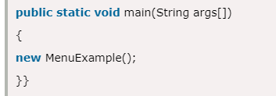
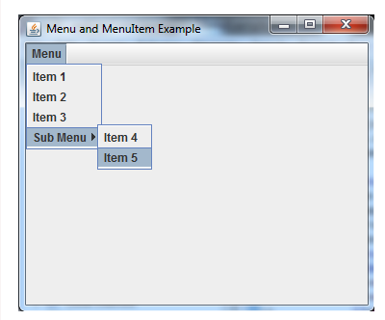

Slide 12
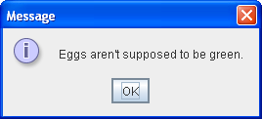
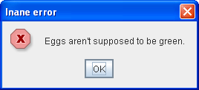
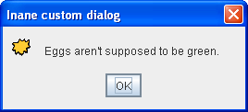
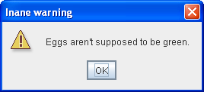
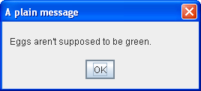
2.6 Dialog Boxes
Option Dialogs, Creating Dialogs, Data Exchange, File Choosers, Color Choosers
JOptionPane.showMessageDialog(frame,
"Eggs are not supposed to be green.");
JOptionPane.showMessageDialog(frame,
"Eggs are not supposed to be green.",
"Inane error",
JOptionPane.ERROR_MESSAGE);
JOptionPane.showMessageDialog(frame,
"Eggs are not supposed to be green.",
"Inane custom dialog",
JOptionPane.INFORMATION_MESSAGE,
icon);
JOptionPane.showMessageDialog(frame,
"Eggs are not supposed to be green.",
"Inane warning",
JOptionPane.WARNING_MESSAGE);
JOptionPane.showMessageDialog(frame,
"Eggs are not supposed to be green.",
"A plain message",
JOptionPane.PLAIN_MESSAGE);

Slide 13
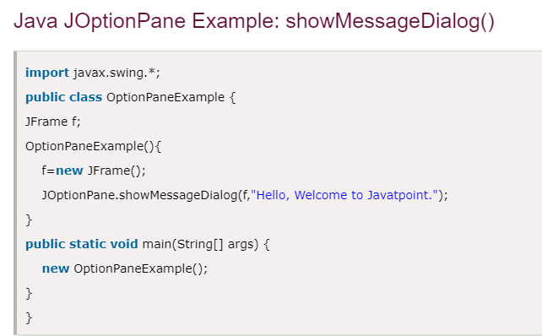
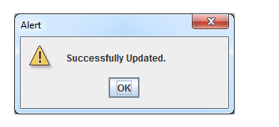
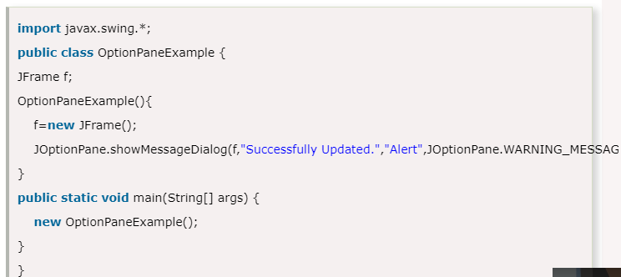
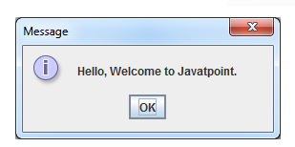

Slide 14
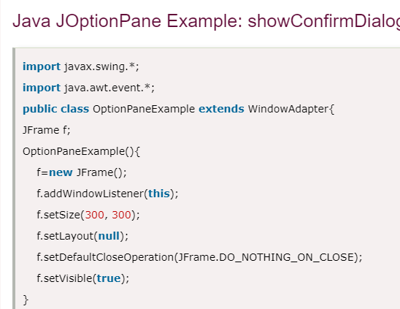
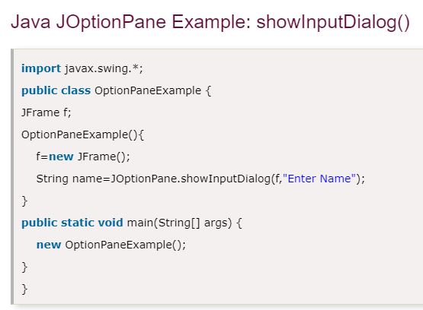
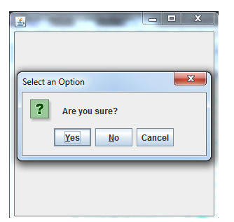
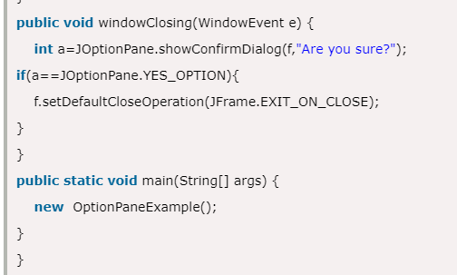
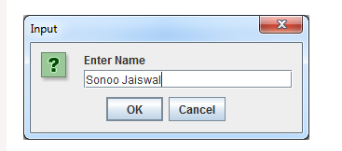

Slide 15
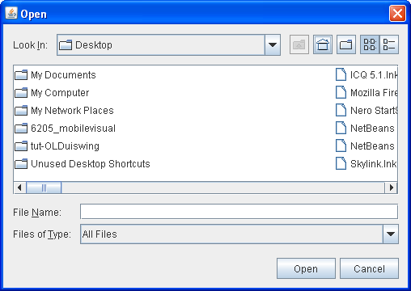
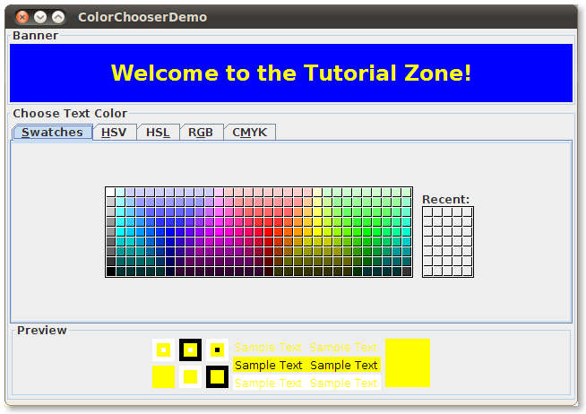
File Choosers/ Color Choosers
//Create a file chooser
final JFileChooser fc = new JFileChooser();
...
//In response to a button click:
int returnVal = fc.showOpenDialog(aComponent);
banner = new JLabel("Welcome to the Tutorial Zone!",
JLabel.CENTER);
banner.setForeground(Color.yellow);
. . .
tcc = new JColorChooser(banner.getForeground());
. . .
add(tcc, BorderLayout.PAGE_END);

Slide 16
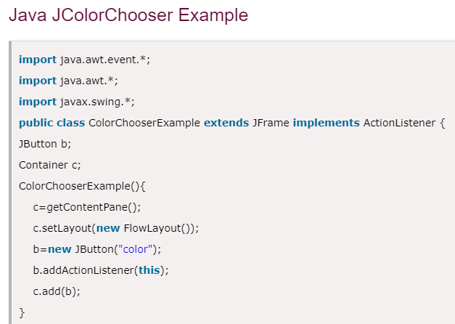
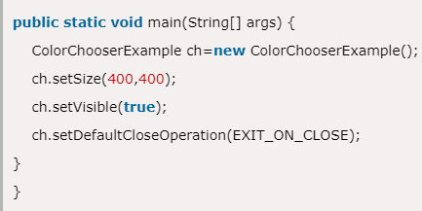
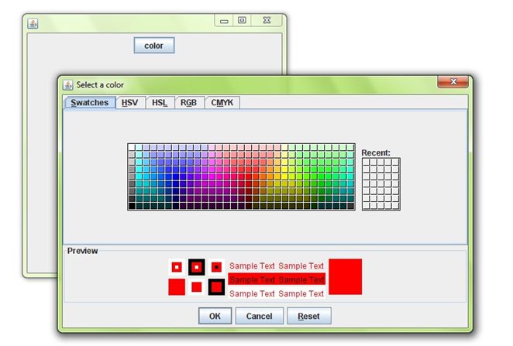
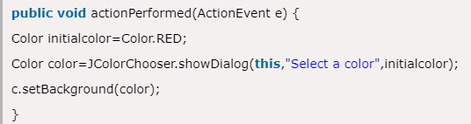

Slide 17
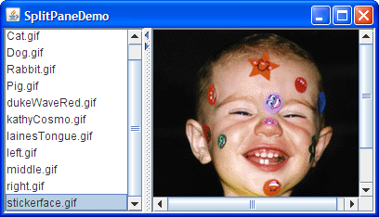
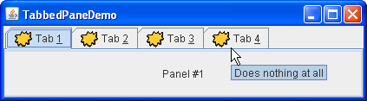
2.7 Components Organizers
split Panes, Tabbed Panes, Desktop Panes and Internal Frames, Cascading and Tiling
splitPane = new JSplitPane(JSplitPane.HORIZONTAL_SPLIT,
listScrollPane, pictureScrollPane);
splitPane.setOneTouchExpandable(true);
splitPane.setDividerLocation(150);
//Provide minimum sizes for the two components in the split pane
Dimension minimumSize = new Dimension(100, 50);
listScrollPane.setMinimumSize(minimumSize);
pictureScrollPane.setMinimumSize(minimumSize);
JTabbedPane tabbedPane = new JTabbedPane();
ImageIcon icon = createImageIcon("images/middle.gif");
JComponent panel1 = makeTextPanel("Panel #1");
tabbedPane.addTab("Tab 1", icon, panel1,
"Does nothing");
tabbedPane.setMnemonicAt(0, KeyEvent.VK_1);

Slide 18
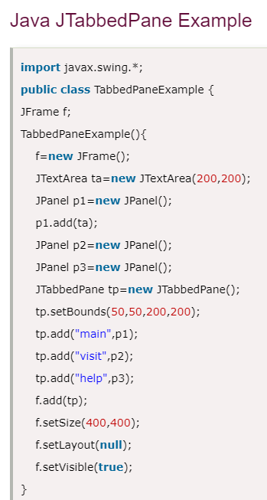

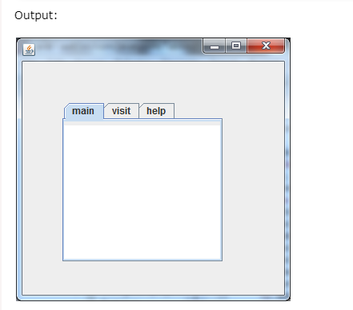

Slide 19
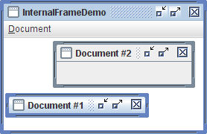
Desktop Panes and Internal Frames
.//In the constructor of InternalFrameDemo, a JFrame subclass:
desktop = new JDesktopPane();
createFrame(); //Create first window
setContentPane(desktop);
...
//Make dragging a little faster but perhaps uglier.
desktop.setDragMode(JDesktopPane.OUTLINE_DRAG_MODE);
With the JInternalFrame class you can display a JFrame-like window within another window. Usually, you add internal frames to a desktop pane. The desktop pane, in turn, might be used as the content pane of a JFrame. The desktop pane is an instance of JDesktopPane, which is a subclass of JLayeredPane that has added API for managing multiple overlapping internal frames.

Slide 20
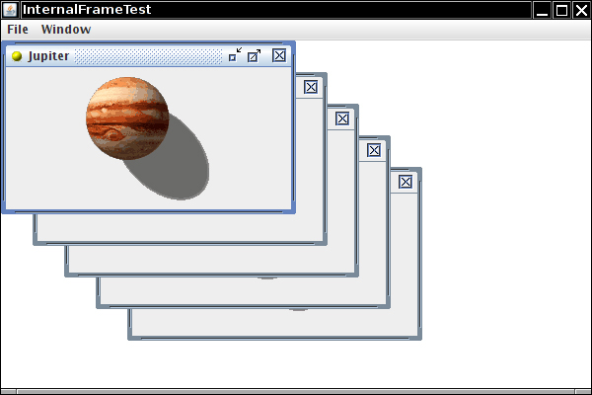
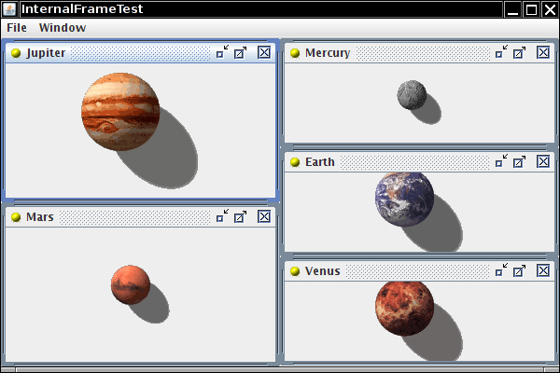
Cascading and Tiling
One of the things that a desktop manage will typically do (although it may not) is resuffle windows and icons around when the pane has been resized.
A desktop manager will possibly do things like re-arranging icons so that they stay at the bottom of the pane. If the manage supports "tiled“ internal frames, then it might re arrange the positions of internal frames. One thing that even the default desktop manager javax.swing.DefaultDesktopManger should to is resize maximizedinternbal frames so that they stay maximized.

Slide 21
package examQuestions;
import javax.swing.*;
public class InternalFrameDemo extends JFrame {
InternalFrameDemo(){
for (int i=0; i<5; i++){
JInternalFrame jInternalFrame = new JInternalFrame("Internal Frame "+i);
jInternalFrame.setLocation(i*50+10, i*50+10);
jInternalFrame.setSize(300, 300);
this.add(jInternalFrame);
jInternalFrame.setVisible(true);
}
setVisible(true);
setSize(1000,1000);
setDefaultCloseOperation(EXIT_ON_CLOSE);
}
public static void main(String[] args) {
new InternalFrameDemo();
}
}

Slide 22
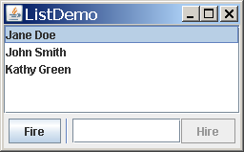
2.8 Advance Swing Components
List, Trees, Tables, Progress Bars
List
A JList presents the user with a group of items, displayed in one or more columns, to choose from. Lists can have many items, so they are often put in scroll panes.
list = new JList(data); //data has type Object[]
list.setSelectionMode(ListSelectionModel.SINGLE_INTERVAL_SELECTION);
list.setLayoutOrientation(JList.HORIZONTAL_WRAP);
list.setVisibleRowCount(-1);
...
JScrollPane listScroller = new JScrollPane(list);
listScroller.setPreferredSize(new Dimension(250, 80));

Slide 23
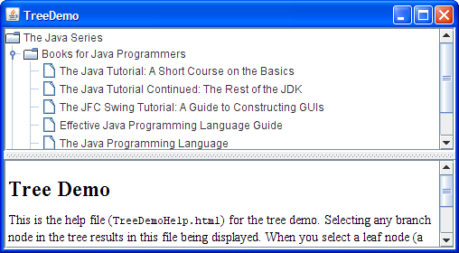
Trees
With the JTree class, you can display hierarchical data. A JTree object does not actually contain your data; it simply provides a view of the data. Like any non-trivial Swing component, the tree gets data by querying its data model.
private JTree tree;
...
public TreeDemo() {
...
DefaultMutableTreeNode top =
new DefaultMutableTreeNode("The Java Series");
createNodes(top);
tree = new JTree(top);
...
JScrollPane treeView = new JScrollPane(tree);

Slide 24
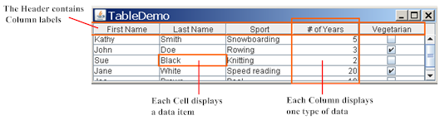
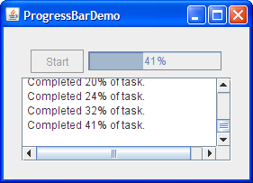
Tables, Progress Bars
JTable table = new JTable(data, columnNames);
//Where member variables are declared:
JProgressBar progressBar;
...
//Where the GUI is constructed:
progressBar = new JProgressBar(0, task.getLengthOfTask());
progressBar.setValue(0);
progressBar.setStringPainted(true);

Slide 25
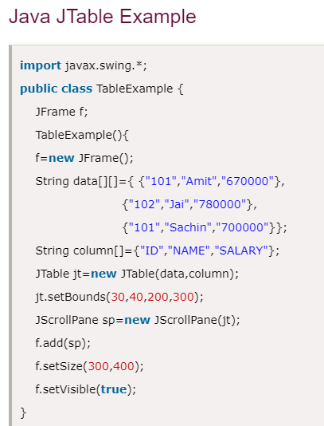
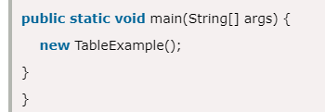
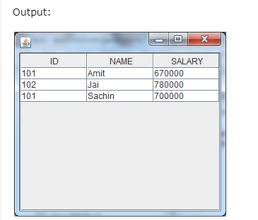

Slide 26
2.2 Layout Management
The LayoutManagers are used to arrange components in a particular manner.
LayoutManager is an interface that is implemented by all the classes of layout managers.
There are following classes that represents the layout managers:
java.awt.BorderLayout
java.awt.GridLayout
java.awt.GridBagLayout
javax.swing.GroupLayout
Using No Layout Managers
Custom Layout Managers

Slide 27

BorderLayout
A BorderLayout places components in up to five areas: top, bottom, left, right, and center. All extra space is placed in the center area.
Tool bars that are created using JToolBar must be created within a BorderLayout container, if you want to be able to drag and drop the bars away from their starting positions.
Constructor or Method | Purpose
BorderLayout(int horizontalGap, int verticalGap) | Defines a border layout with specified gaps between components.
setHgap(int) | Sets the horizontal gap between components.
setVgap(int) | Sets the vertical gap between components.

Slide 28




Slide 29

GridLayout
GridLayout simply makes a bunch of components equal in size and displays them in the requested number of rows and columns.
The Constructors used are:
GridLayout(int rows, int cols)
GridLayout(int rows, int cols, int hgap, int vgap)
.
GridLayout experimentLayout = new GridLayout(0,2);
compsToExperiment.setLayout(experimentLayout);
compsToExperiment.add(new JButton("Button 1"));
compsToExperiment.add(new JButton("Button 2"));
compsToExperiment.add(new JButton("Button 3"));
compsToExperiment.add(new JButton("Long-Named Button 4"));
compsToExperiment.add(new JButton("5"));

Slide 30




Slide 31

GridBagLayout
GridBagLayout is a sophisticated, flexible layout manager.
It aligns components by placing them within a grid of cells, allowing components to span more than one cell.
The rows in the grid can have different heights, and grid columns can have different widths.
JPanel pane = new JPanel(new GridBagLayout());
GridBagConstraints c = new GridBagConstraints();
//For each component to be added to this container:
//...Create the component...
//...Set instance variables in the GridBagConstraints instance...
pane.add(theComponent, c);

Slide 32

GroupLayout
GroupLayout is a layout manager that was developed for use by GUI builder tools, but it can also be used manually.
GroupLayout works with the horizontal and vertical layouts separately. The layout is defined for each dimension independently.
Consequently, however, each component needs to be defined twice in the layout. The Find window shown above is an example of a GroupLayout.
You do not need to worry about the vertical dimension when defining the horizontal layout, and vice versa, as the layout along each axis is totally independent of the layout along the other axis.
GroupLayout layout = new GroupLayout(panel);
panel.setLayout(layout);
We specify automatic gap insertion:
layout.setAutoCreateGaps(true);
layout.setAutoCreateContainerGaps(true);

Slide 33

GroupLayout works with the horizontal and vertical layouts separately. The layout is defined for each dimension independently.
GroupLayout uses two types of arrangements -- sequential and parallel, combined with hierarchical composition.
In pseudo code, the layout specification now looks like this:
horizontal layout = sequential group { c1, c2, parallel group (LEFT) { c3, c4 } }
vertical layout = sequential group { parallel group (BASELINE) { c1, c2, c3 }, c4 }

Slide 34

Doing Without a Layout Manager (Absolute Positioning)
Although it is possible to do without a layout manager, you should use a layout manager if at all possible. A layout manager makes it easier to adjust to look-and-feel-dependent component appearances, to different font sizes, to a container's changing size, and to different locales. Layout managers also can be reused easily by other containers, as well as other programs.
pane.setLayout(null);
JButton b1 = new JButton("one");
JButton b2 = new JButton("two");
JButton b3 = new JButton("three");
pane.add(b1);
pane.add(b2);
pane.add(b3);

Slide 35

Creating a Custom Layout Manager
To create a custom layout manager, you must create a class that implements the LayoutManager interface. You can either implement it directly, or implement its subinterface, LayoutManager2.
Every layout manager must implement at least the following five methods, which are required by the LayoutManager interface:
1. void addLayoutComponent(String, Component)
2. void removeLayoutComponent(Component)
3. Dimension preferredLayoutSize(Container)
4. Dimension minimumLayoutSize(Container)
5. void layoutContainer(Container)
If you wish to support component constraints, maximum sizes, or alignment, then your layout manager should implement the LayoutManager2 interface. In fact, for these reasons among many others, nearly all modern layout managers will need to implement LayoutManager2. That interface adds five methods to those required by LayoutManager:
addLayoutComponent(Component, Object)
getLayoutAlignmentX(Container)
getLayoutAlignmentY(Container)
invalidateLayout(Container)
maximumLayoutSize(Container)

Slide 36

FlowLayout
import java.awt.*;
import javax.swing.*;
public class MyFlowLayout{
JFrame f;
MyFlowLayout(){
f=new JFrame();
JButton b1=new JButton("1");
JButton b2=new JButton("2");
JButton b3=new JButton("3");
JButton b4=new JButton("4");
JButton b5=new JButton("5");
f.add(b1);f.add(b2);f.add(b3);f.add(b4);f.add(b5);
f.setLayout(new FlowLayout(FlowLayout.RIGHT));
//setting flow layout of right alignment
f.setSize(300,300);
f.setVisible(true);
}
public static void main(String[] args) {
new MyFlowLayout();
}
}

Slide 37
Event and Listener (Java Event Handling)
Changing the state of an object is known as an event. For example, click on button, dragging mouse etc. The java.awt.event package provides many event classes and Listener interfaces for event handling.
Event Classes | Listener Interfaces
ActionEvent | ActionListener
MouseEvent | MouseListener and MouseMotionListener
MouseWheelEvent | MouseWheelListener
KeyEvent | KeyListener
ItemEvent | ItemListener
TextEvent | TextListener
AdjustmentEvent | AdjustmentListener
WindowEvent | WindowListener
ComponentEvent | ComponentListener
ContainerEvent | ContainerListener
FocusEvent | FocusListener

Slide 38
Registration Methods
Button
public void addActionListener(ActionListener a){}
MenuItem
public void addActionListener(ActionListener a){}
TextField
public void addActionListener(ActionListener a){}
public void addTextListener(TextListener a){}
TextArea
public void addTextListener(TextListener a){}
Checkbox
public void addItemListener(ItemListener a){}
Choice
public void addItemListener(ItemListener a){}
List
public void addActionListener(ActionListener a){}
public void addItemListener(ItemListener a){}

Slide 39

Java event handling by implementing ActionListener
import java.awt.*;
import java.awt.event.*;
class AEvent extends Frame implements ActionListener{
TextField tf;
AEvent(){
//create components
tf=new TextField();
tf.setBounds(60,50,170,20);
Button b=new Button("click me");
b.setBounds(100,120,80,30);
//register listener
b.addActionListener(this);//passing current instance
//add components and set size, layout and visibility
add(b);add(tf);
setSize(300,300);
setLayout(null);
setVisible(true);
}
public void actionPerformed(ActionEvent e){
tf.setText("Welcome");
}
public static void main(String args[]){
new AEvent();
}
}

Slide 40

MouseListener Example
import java.awt.*;
import java.awt.event.*;
public class MouseListenerExample extends Frame implements MouseListener{
Label l;
MouseListenerExample(){
addMouseListener(this);
l=new Label();
l.setBounds(20,50,100,20);
add(l);
setSize(300,300);
setLayout(null);
setVisible(true);
}
public void mouseClicked(MouseEvent e) {
l.setText("Mouse Clicked");
}
public void mouseEntered(MouseEvent e) {
l.setText("Mouse Entered");
}
public void mouseExited(MouseEvent e) {
l.setText("Mouse Exited");
}
public void mousePressed(MouseEvent e) {
l.setText("Mouse Pressed");
}
public void mouseReleased(MouseEvent e) {
l.setText("Mouse Released");
}
public static void main(String[] args) {
new MouseListenerExample();
}
}

Slide 41

ItemListener Interface
import java.awt.*;
import java.awt.event.*;
public class ItemListenerExample implements ItemListener{
Checkbox checkBox1,checkBox2;
Label label;
ItemListenerExample(){
Frame f= new Frame("CheckBox Example");
label = new Label();
label.setAlignment(Label.CENTER);
label.setSize(400,100);
checkBox1 = new Checkbox("C++");
checkBox1.setBounds(100,100, 50,50);
checkBox2 = new Checkbox("Java");
checkBox2.setBounds(100,150, 50,50);
f.add(checkBox1); f.add(checkBox2); f.add(label);
checkBox1.addItemListener(this);
checkBox2.addItemListener(this);
f.setSize(400,400);
f.setLayout(null);
f.setVisible(true);
}
public void itemStateChanged(ItemEvent e) {
if(e.getSource()==checkBox1)
label.setText("C++ Checkbox: "
+ (e.getStateChange()==1?"checked":"unchecked"));
if(e.getSource()==checkBox2)
label.setText("Java Checkbox: "
+ (e.getStateChange()==1?"checked":"unchecked"));
}
public static void main(String args[])
{
new ItemListenerExample();
}
}

Slide 42
Java Adapter Classes
Java adapter classes provide the default implementation of listener interfaces. If you inherit the adapter class, you will not be forced to provide the implementation of all the methods of listener interfaces. So it saves code.
In an adapter class, there is no need for implementation of all the methods presented in an interface. It is used when only some methods of defined by its interface have to be overridden.
In a listener, all the methods that have been declared in its interface have to be implemented. This is because these methods are
Adapter class | Listener interface
WindowAdapter | WindowListener
KeyAdapter | KeyListener
MouseAdapter | MouseListener
MouseMotionAdapter | MouseMotionListener
FocusAdapter | FocusListener
ComponentAdapter | ComponentListener
ContainerAdapter | ContainerListener

Slide 43

Java MouseAdapter Example
import java.awt.*;
import java.awt.event.*;
public class MouseAdapterExample extends MouseAdapter{
Frame f;
MouseAdapterExample(){
f=new Frame("Mouse Adapter");
f.addMouseListener(this);
f.setSize(300,300);
f.setLayout(null);
f.setVisible(true);
}
public void mouseClicked(MouseEvent e) {
Graphics g=f.getGraphics();
g.setColor(Color.BLUE);
g.fillOval(e.getX(),e.getY(),30,30);
}
public static void main(String[] args) {
new MouseAdapterExample();
}
}

Slide 44

MouseMotionAdapter Example
import java.awt.*;
import java.awt.event.*;
public class MouseMotionAdapterExample extends MouseMotionAdapter{
Frame f;
MouseMotionAdapterExample(){
f=new Frame("Mouse Motion Adapter");
f.addMouseMotionListener(this);
f.setSize(300,300);
f.setLayout(null);
f.setVisible(true);
}
public void mouseDragged(MouseEvent e) {
Graphics g=f.getGraphics();
g.setColor(Color.ORANGE);
g.fillOval(e.getX(),e.getY(),20,20);
}
public static void main(String[] args) {
new MouseMotionAdapterExample();
}
}

Slide 45


Classworks (Some Applications)

Slide 46



